Slide 1
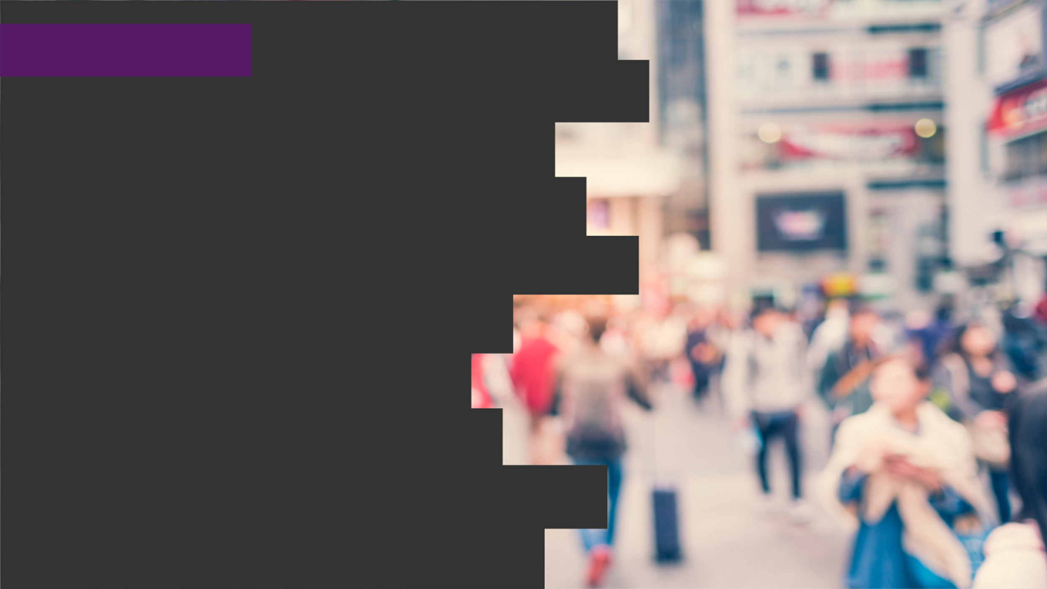

2020
Netcoreconf
Azure Durable Functions: Detrás de la magia
Juan Carlos Martinez (AKA “el niño del raval”)
Luis Mañez
18/01/2020
Technical architect “Mr. Connect” (ClearPeople LTD)
Cloud Solutions Architect (ClearPeople LTD)
@jcmartinezg23
@luismanez

Slide 2
Sponsors

Slide 3
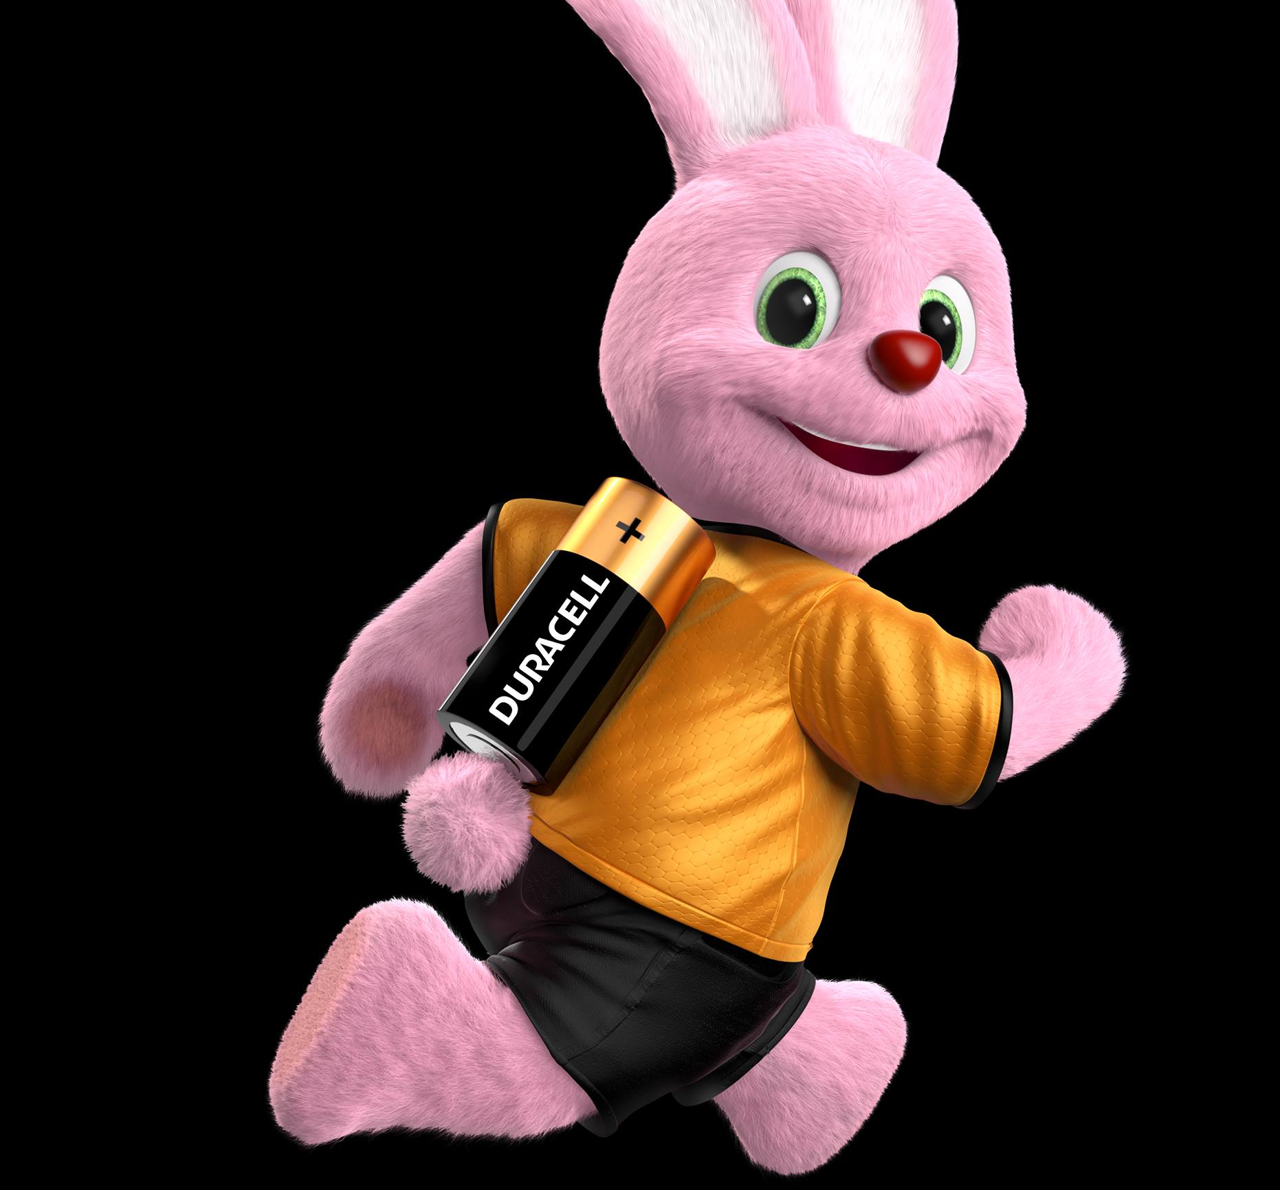
What are
“Azure Durable Functions”?

Slide 4
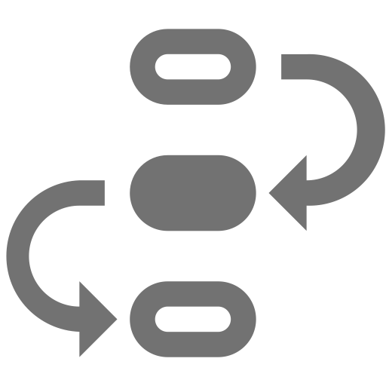


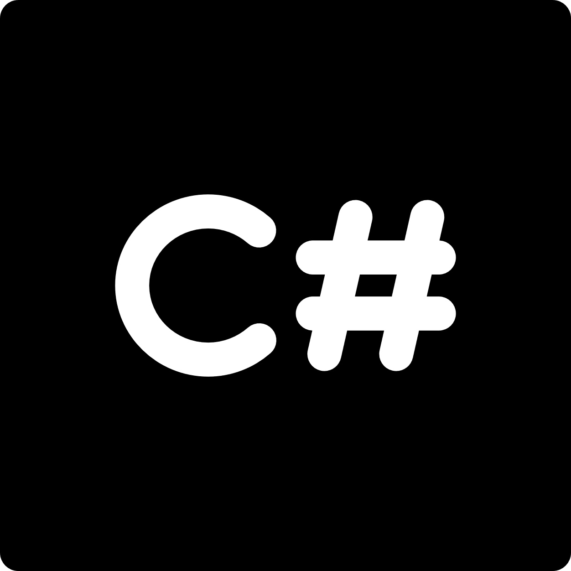

stateful functions in
serverless environment
workflow in code
azure functions extension
languages
F#

Slide 5
Durable Functions Application Patterns

Slide 6
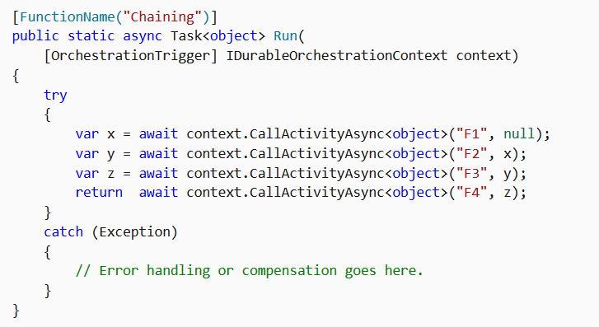
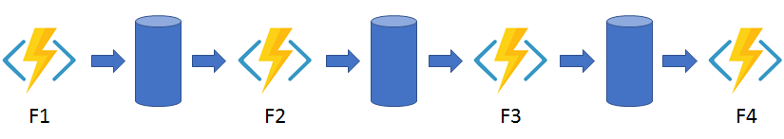
Function chaining

Slide 7
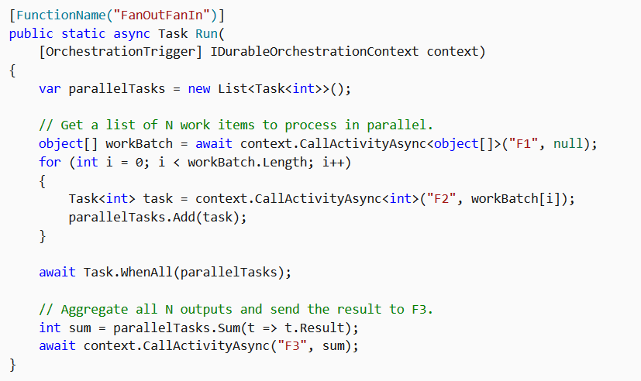
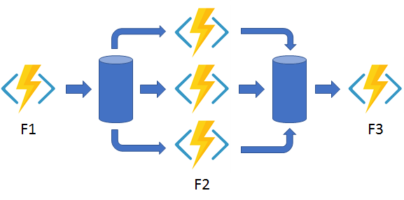
Fan out/fan in

Slide 8
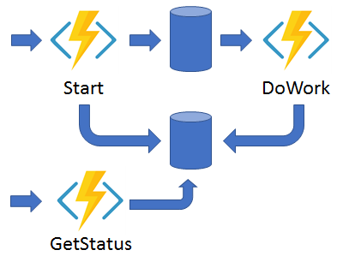
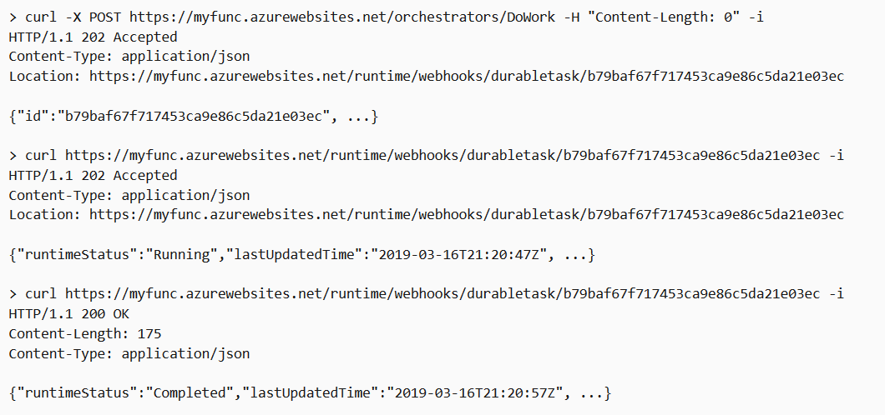
Async HTTP APIs

Slide 9
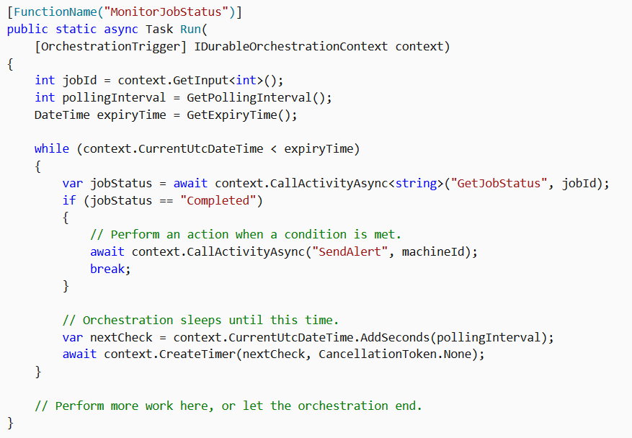
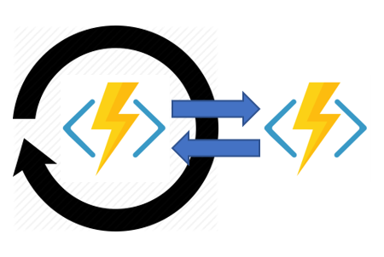
Monitor

Slide 10
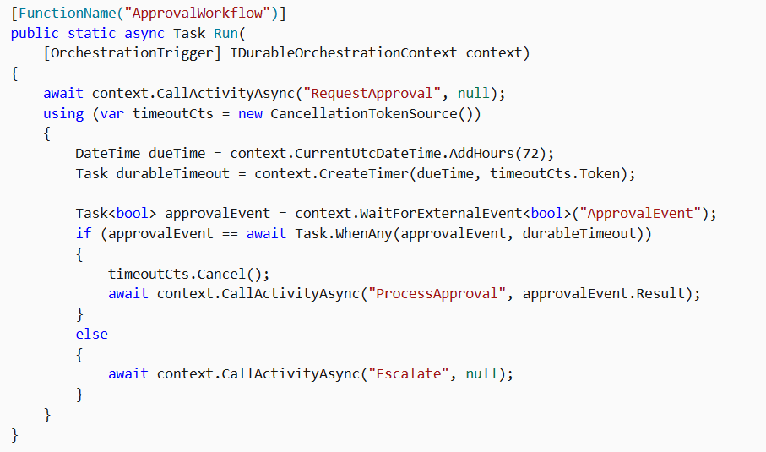
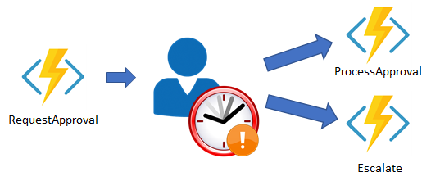
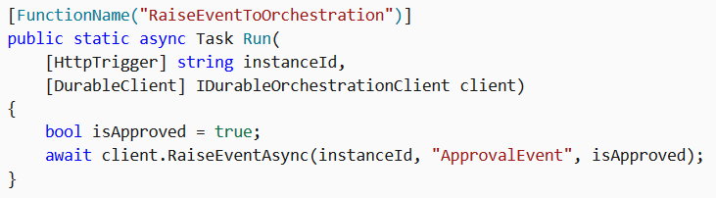
Human interaction
curl -d "true" http://localhost:7071/runtime/webhooks/durabletask/instances/{instanceId}/raiseEvent/ApprovalEvent -H "Content-Type: application/json"

Slide 11
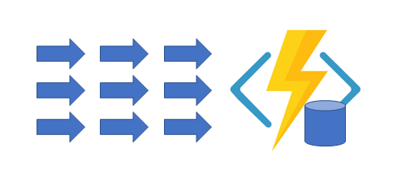
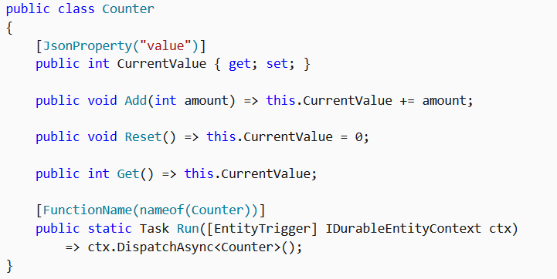
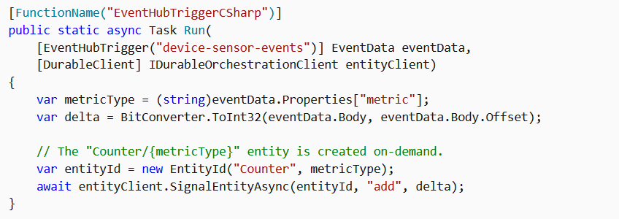
Aggregator

Slide 12
Sponsors

Slide 13
Más información:
info@netcoreconf.com
@Netcoreconf
Visítanos en:
netcoreconf.com
GRACIAS

